Slide 1
Low-carbon Innovations
Prof. Susanna Berkouwer
Business Economics and Public Policy

Slide 2
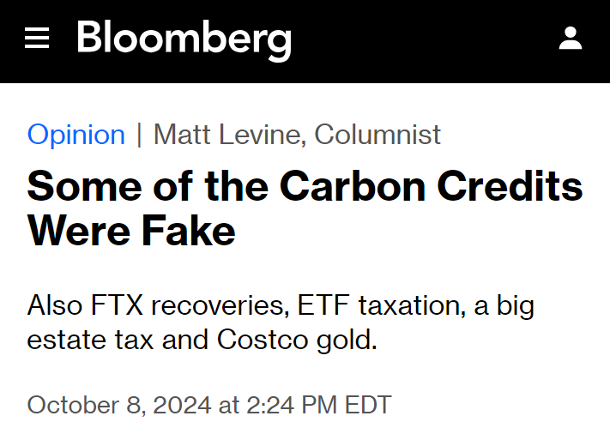
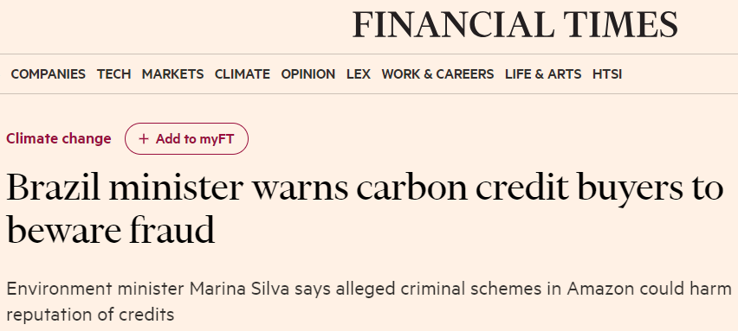
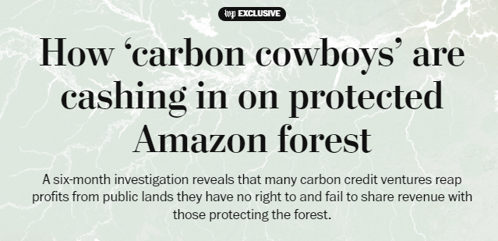
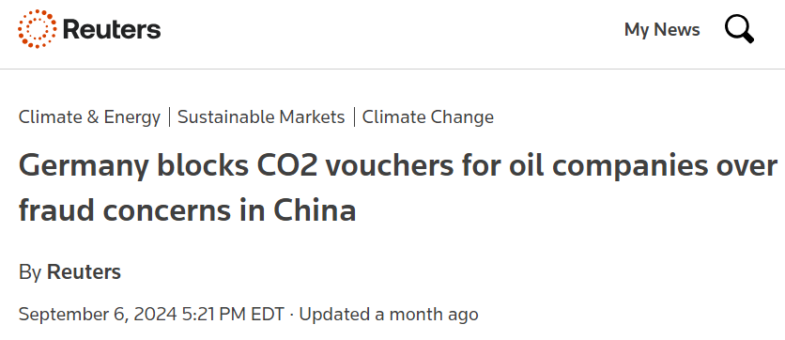


How should companies achieve Net Zero targets?

Slide 3
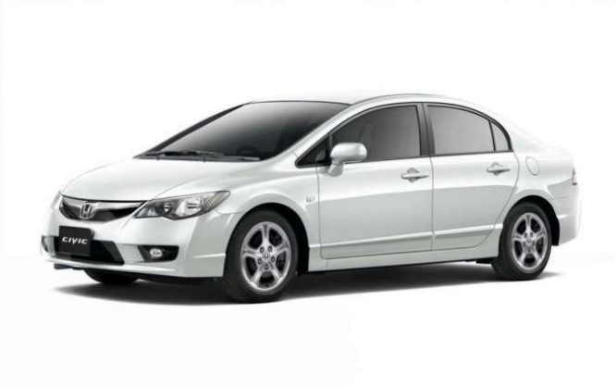
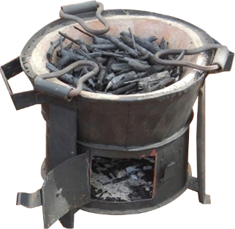
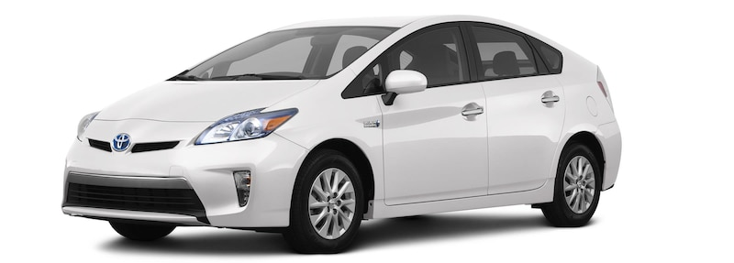
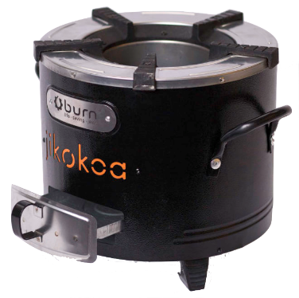
Why use offsets? Compare two green technologies:
Gasoline vehicle
Traditional charcoal stove
11,000 miles per year, 22 miles per gallon (EPA)
Emits 4 tCO₂e per year
850kg charcoal per year (Berkouwer and Dean, 2022)
Emits 9tCO₂e per year
Electric vehicle
Modern charcoal stove
Emits 0tCO₂e (best case scenario)
Emits 4.5tCO₂e (Berkouwer and Dean, 2022)
$10,000 premium
$30
premium

Slide 4
The cost of reducing CO₂e
Technology | Spending per tCO₂e
Improved charcoal stove | $5
Solar lamps | $10
Wind production | $46
Residential solar | $100
Energy-efficient appliance rebates | $470
Weatherization programs | $779
Sustainable aviation fuel | $1,460
Electric Vehicles | $1,685
Hybrid Vehicles | $5,892
Reduction from $1,000,000
200,000 tCO₂e
100,000 tCO₂e
22,000 tCO₂e
10,000 tCO₂e
2,100 tCO₂e
1,300 tCO₂e
685 tCO₂e
600 tCO₂e
170 tCO₂e
Spend $120 billion on 4 billion stoves or on 12 million cars?

Slide 5
Project 1: Spurring the widespread adoption of induction cookstoves

Slide 6
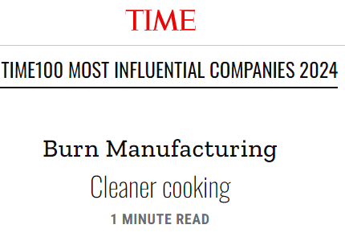
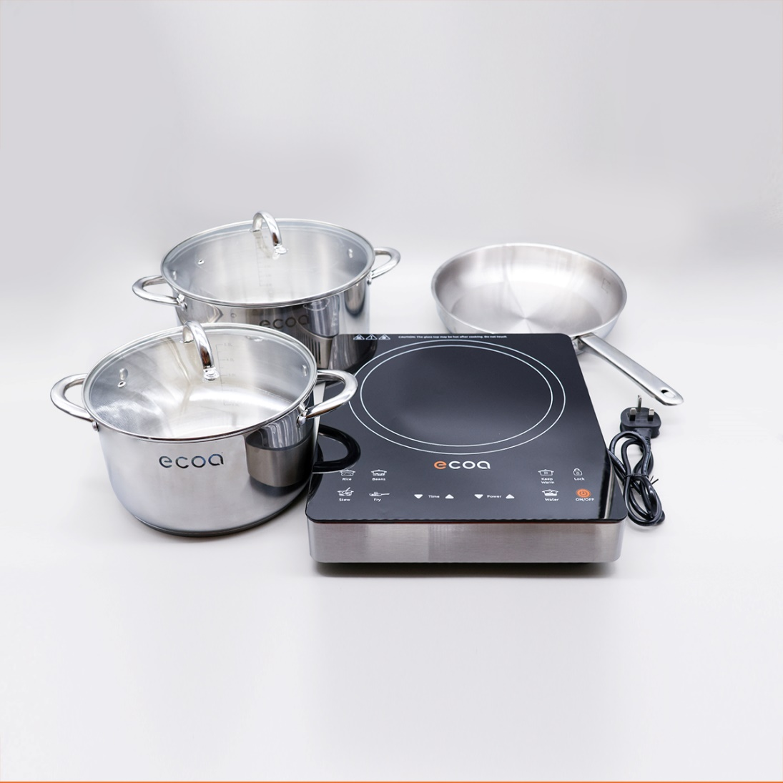
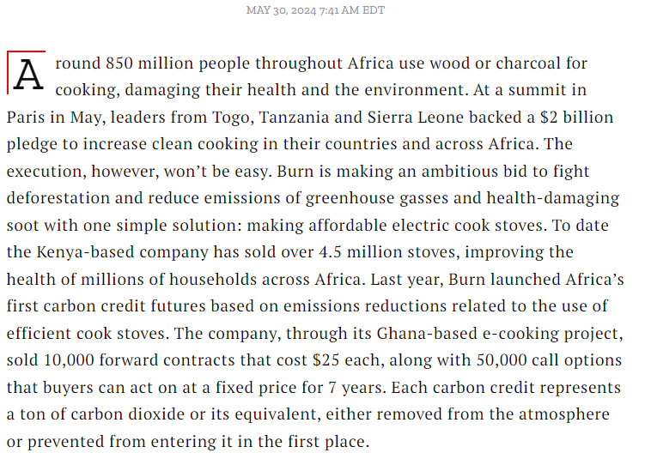

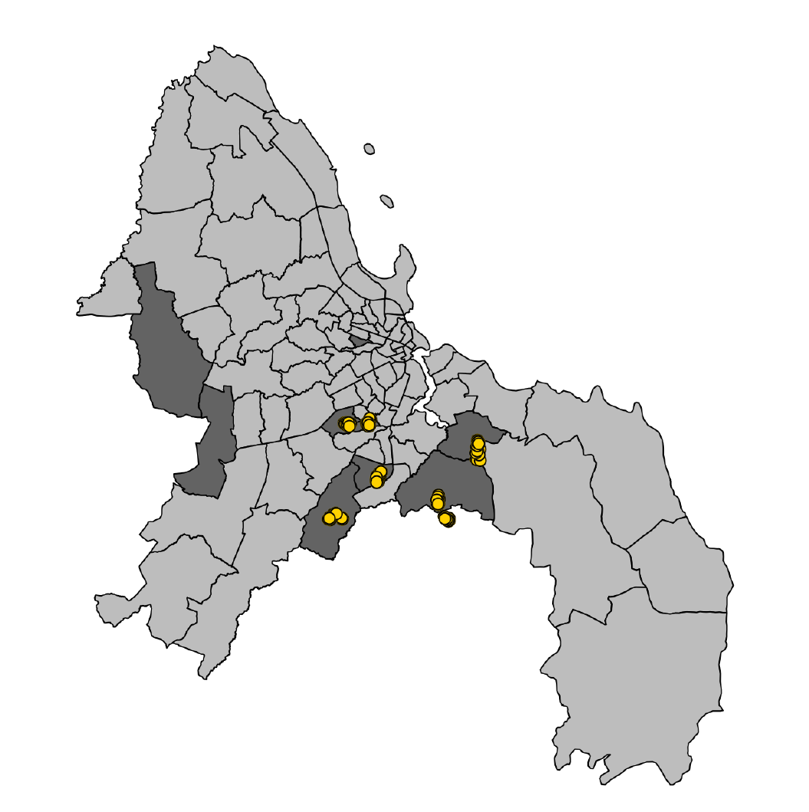
Electric cookstoves in Tanzania
Dar es Salaam, Tanzania

Slide 7
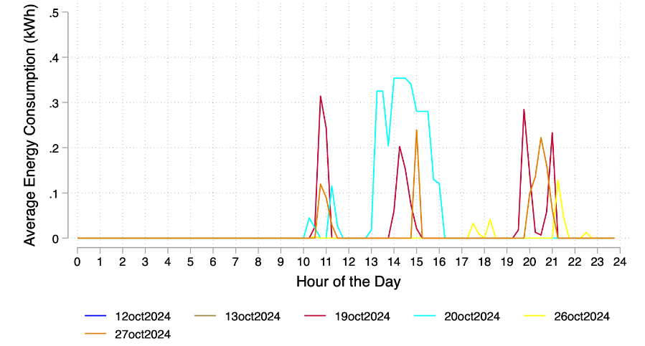
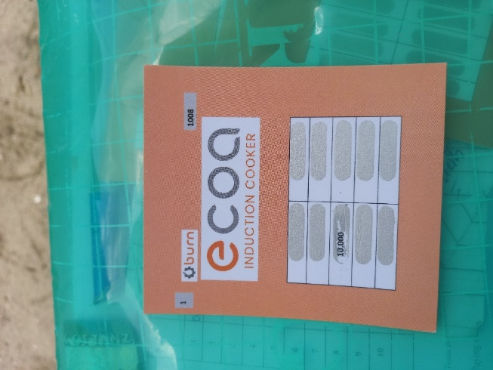
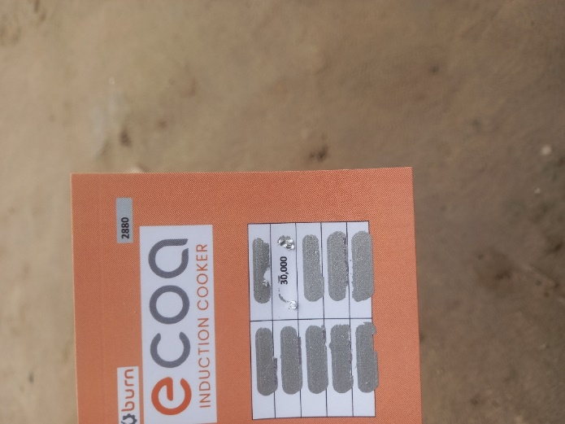
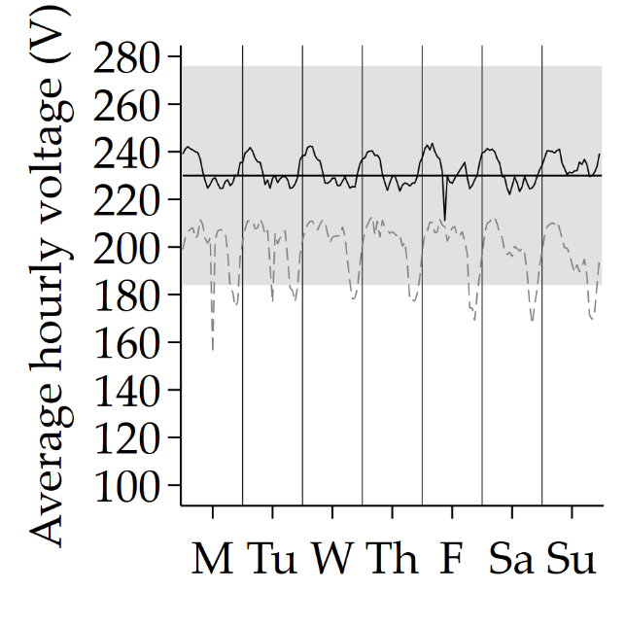
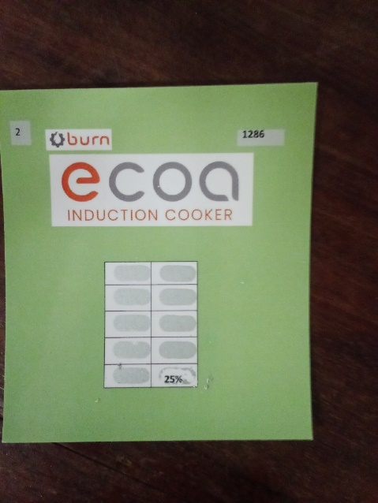
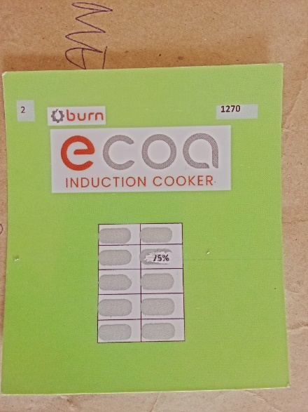

Electric cookstoves in Tanzania: Pilot
200 households surveyed between 9 Oct – 28 Oct (around 18 per day)
Randomized prices using scratchcards:
The electric stoves generate high-frequency usage data:
Power outages and voltage quality
Randomized electricity subsidies

Slide 8

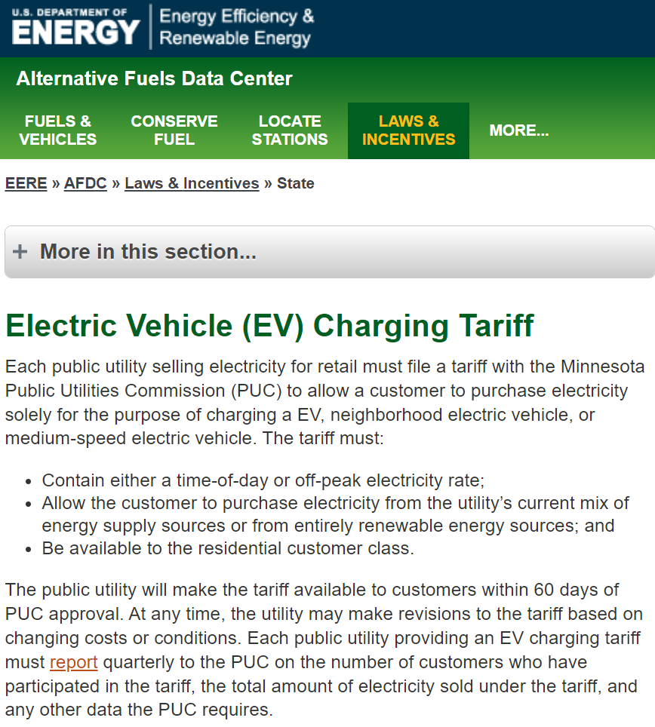
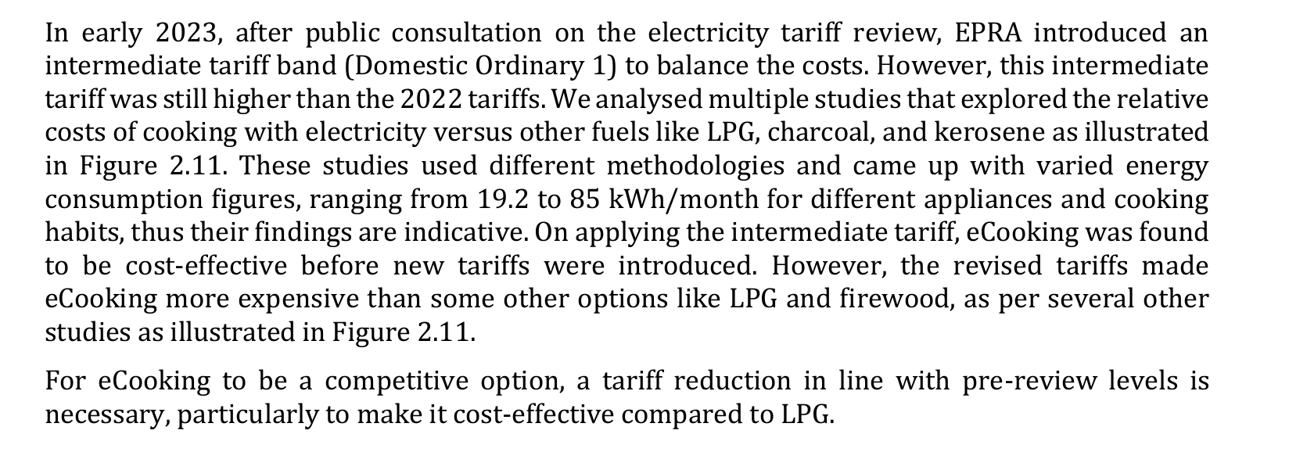
Electric cookstoves in Tanzania: Pilot
Endline planned to launch Dec 4
Qualitative experiences: taste, ease of use, power outages, etc.
Net savings: Electricity spending and charcoal spending
Main study to launch June 1, 2025
2,000+ households
Main research question: if a government, firm, or philanthropic organization wants to spend $1 to reduce emissions, should they spend it on…
… lowering the upfront cost?
Better if people face credit constraints
Better if people
… or lowering the price of electricity (tariffs)?
Better to avoid people buying but not using it
Increases adoption on the “intensive margin”

Slide 9
Project 2: THE EFFICIENCY OF CARBON OFFSETS

Slide 10
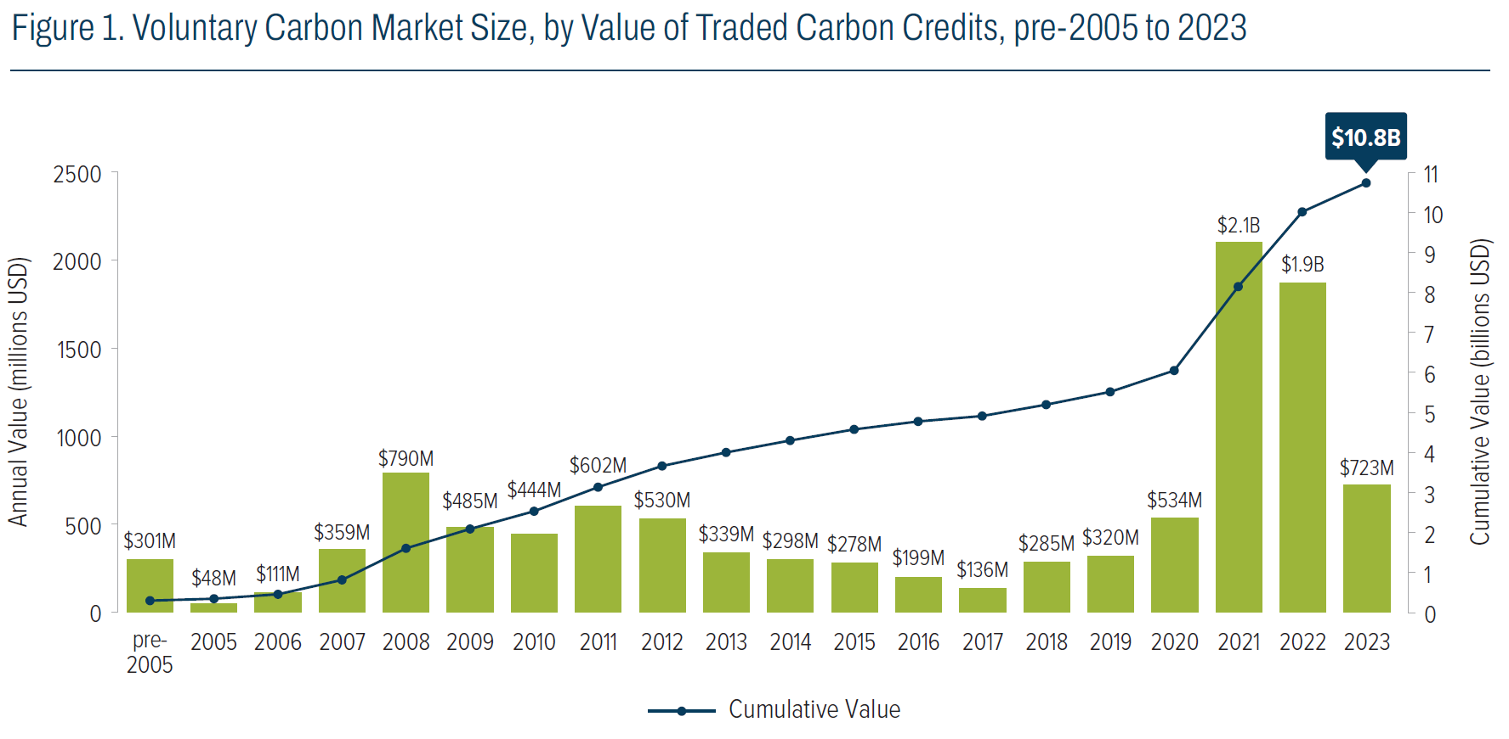

Slide 11
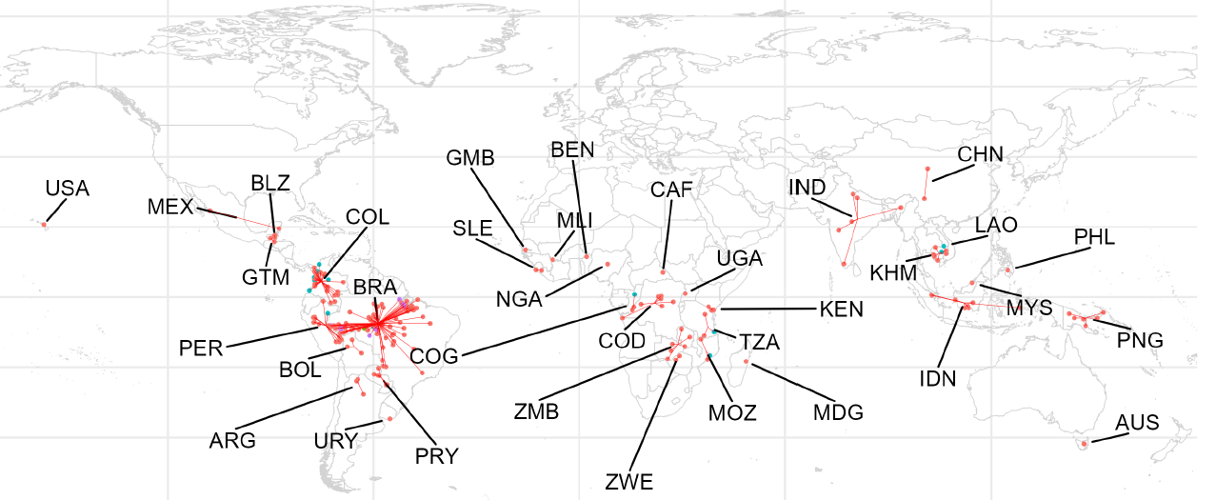
1. How much do offsets really offset?
1. Cookstoves
2. Deforestation
224 REDD+ projects (recently signed an NDA to obtain more):

Slide 12
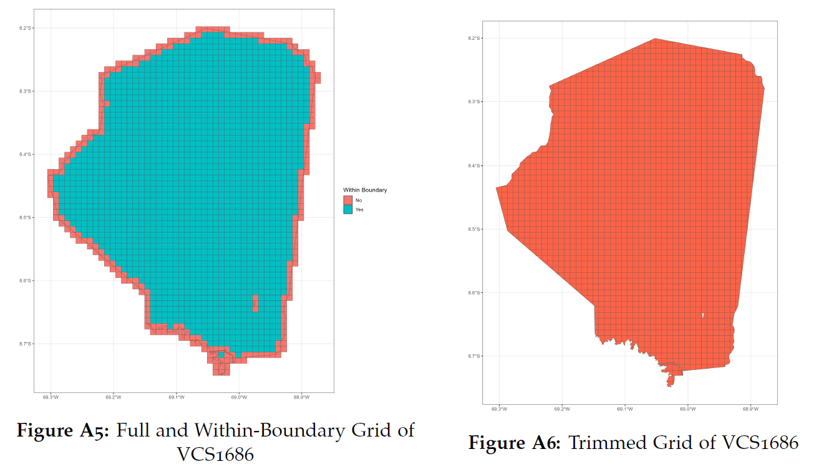
1. How much do offsets really offset?

Slide 13
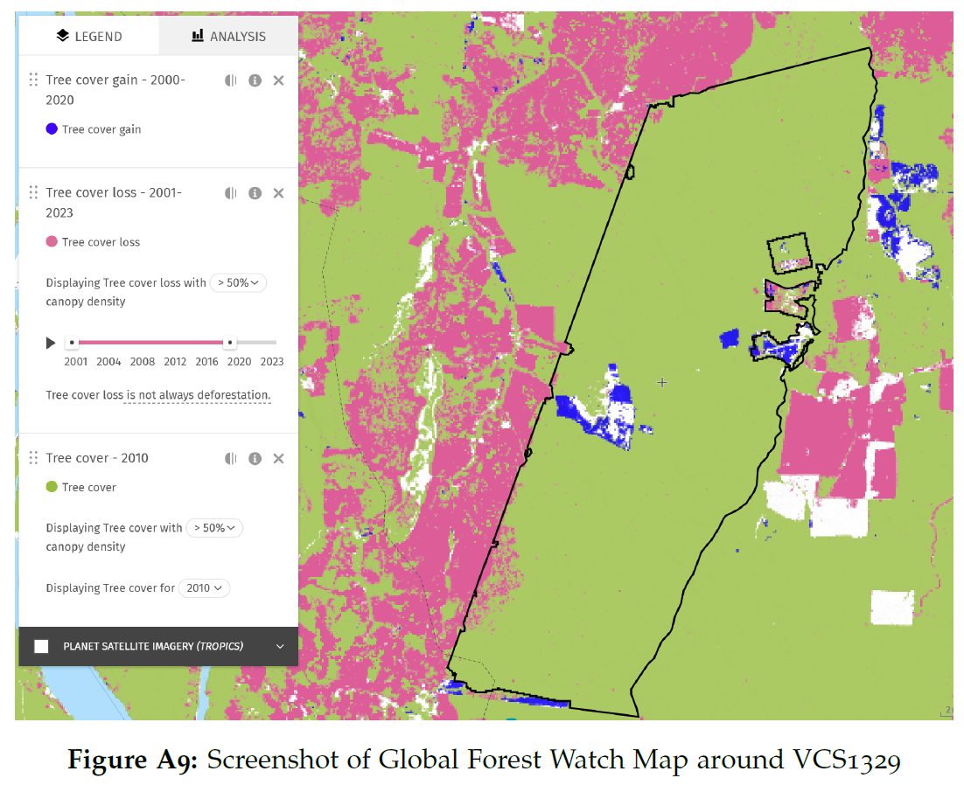
1. How much do offsets really offset?

Slide 14
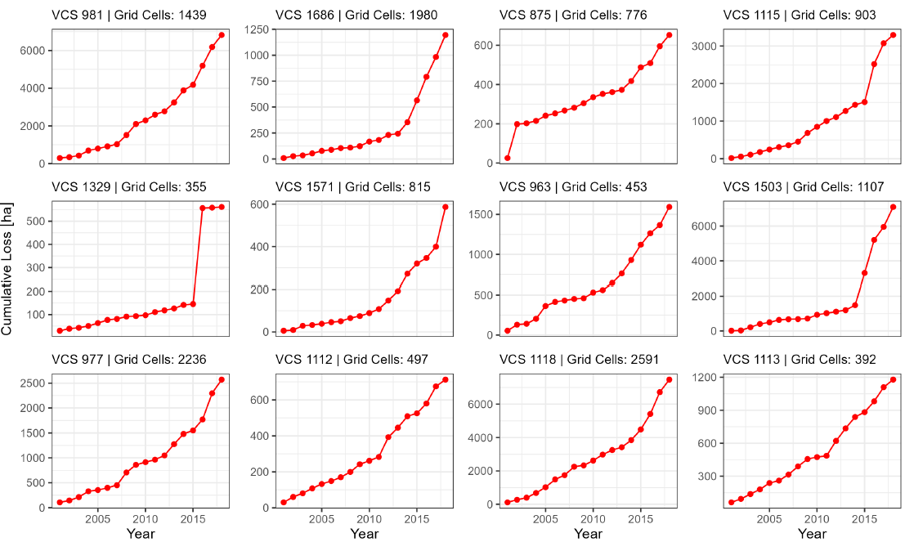

1. How much do offsets really offset?
Gold Standard
Verra
CORSIA
Etc.
1. Cookstoves
2. Deforestation
224 REDD+ projects (recently signed an NDA to obtain more)
Multiple econometric estimation methods:
“Donut” method:
Propensity score matching and synthetic control:
Percentage treecover
Biomass density
Deforestation history
Distance to road, ocean

Slide 15
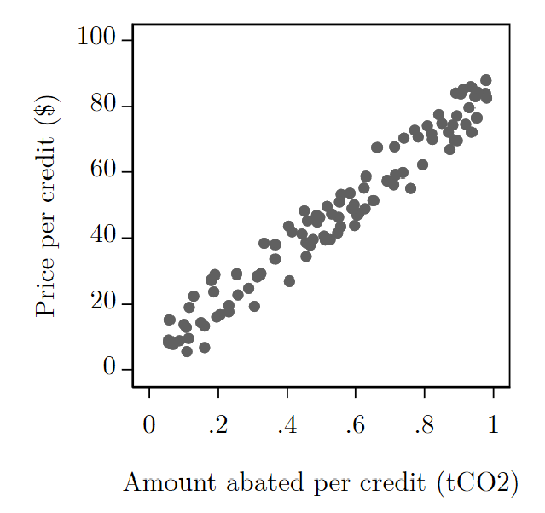
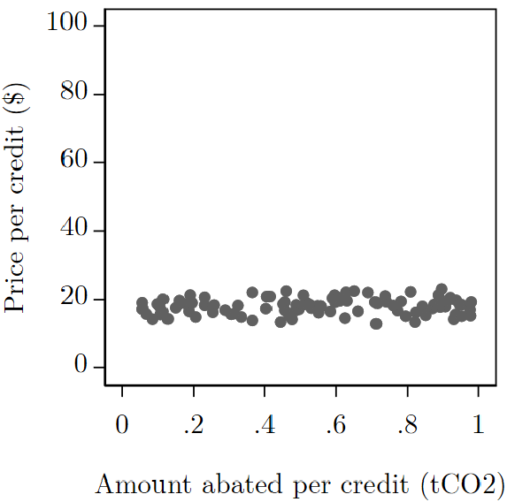
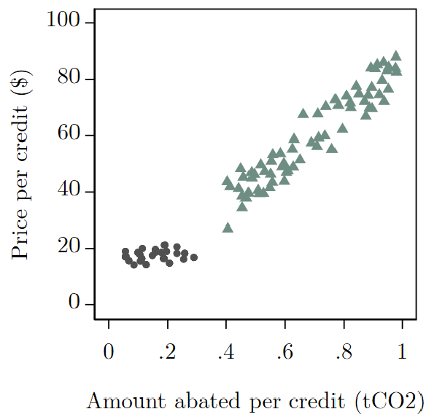
2. Do prices and quality correlate?
If buyers factor in quality when purchasing offsets, the market may be efficient:
If buyers lack information (‘adverse selection’), this will unravel the market:
High-quality institutions may be able to solve information asymmetry:

Slide 16


Prof. Susanna Berkouwer
Business Economics and Public Policy
sberkou@wharton.upenn.edu

